Slide 1
CHAP V: MS TOOLS
PART 2: MS EXCEL

Slide 2

1. What is Microsoft Excel ?
Microsoft Excel is a spreadsheet developed by Microsoft for Windows, macOS, Android and iOS. It features calculation, graphing tools, pivot tables, and a macro programming language called Visual Basic for Applications.
Original author: Microsoft Corporation
Programming language: C#, C++, Microsoft Foundation Class Library, .NET

Slide 3
2. EXCEL Basics
Layout (Tabs, Ribbon, Groups and Launch Button , Spreadsheet)
Spreadsheet (Column, Row, Cell & Range, sheet, Workbook)
Move around Spreadsheet
Being On and In the cell
Enter Data
Merging cells
Fitting data in the cell

Slide 4
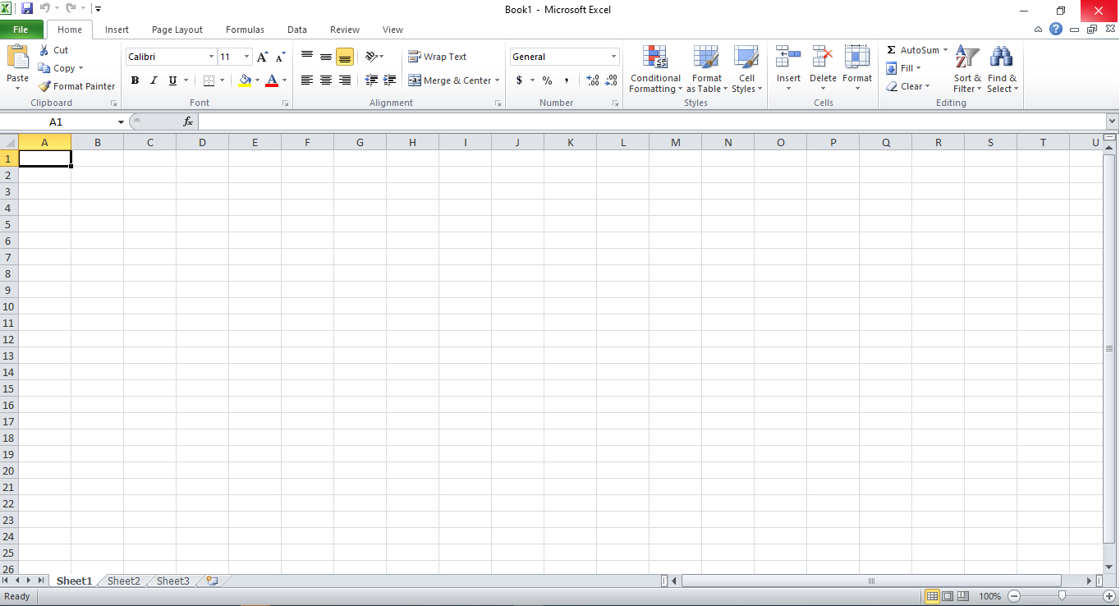
MS Excel Layout

Slide 5
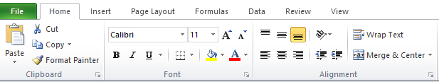
LAYOUT- TABS, RIBBON,GROUPS & LAUNCH BUTTON
TABS
GROUP
RIBBON
LAUNCH BUTTON

Slide 6
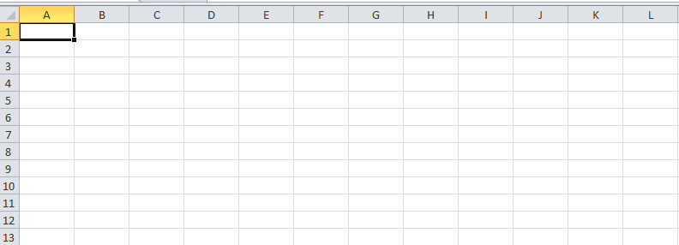
LAYOUT - SPREAD SHEET
COLUMN
(C)
CELL
(C:4)
ROW
(4)
RANGE
(F7:H10)

Slide 7
3. EXCEL TIPS
Use Pivot Tables to recognize and make sense of data.
Add more than one row or column.
Use filters to simplify your data.
Remove duplicate data points or sets.
Transpose rows into columns.
Split up text information between columns.

Slide 8
Contd…
Use conditional formatting to make cells automatically change color based on data.
Use IF THEN Excel formula to automate certain Excel functions.
Use dollar signs to keep one cell's formula the same regardless of where it moves.

Slide 9
Contd…
Use COUNTIF function to make Excel count words or numbers in any range of cells.
Combine cells using and persand.
Add checkboxes.
Hyperlink a cell to a website.
Add drop-down menus.

Slide 10
4. EXCEL TRICKS
One Click to Select All
Open Excel Files in Bulk
Shift Between Different Excel Files
Create a New Shortcut Menu
Add a Diagonal Line to a Cell
Add More Than One New Row or Column
Speedily Move and Copy Data in Cells
Speedily Delete Blank Cells
Vague Search with Wild Card

Slide 11
Contd …
Generate a Unique Value in a Column
Input Restriction with Data Validation Function
Fast Navigation with Ctrl + Arrow Button
Transpose Data from a Row to a Column
Hide Data Thoroughly
Compose Text with &
Transforming the Case of Text
Input Values Starting with 0
Speed up Inputting Complicated Terms with AutoCorrect
One Click to Get More Status
Rename a Sheet Using Double Click

Slide 12
5.EXCEL FORMULA
Cell references
All formulas return a result
Copy and paste formulas
Relative and absolute references
How to enter a formula

Slide 13
6.EXCEL FUNCTIONS
The SUM and SUMIF Function
The TEXT Function
The VLOOKUP Function
The AVERAGE Function
The CONCATENATE Function

